Slide 1
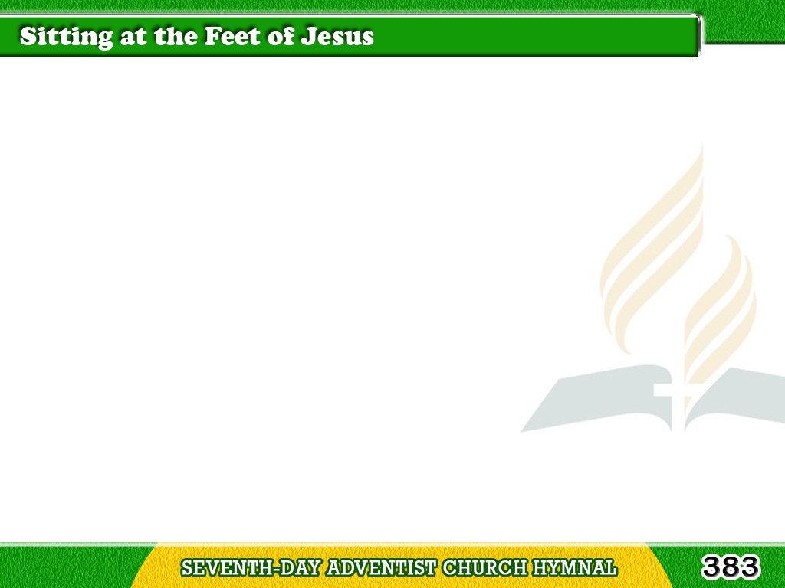
1/3
Sitting at the feet of Jesus,
O what words I hear Him say!
Happy place!
So near, so precious!
May it find me there each day;
Tagalog
Version

Slide 2
1/3
Sitting at the feet of Jesus,
I would look upon the past,
For His love
has been so gracious,
It has won my heart at last.
Tagalog
Version

Slide 3
2/3
Sitting at the feet of Jesus,
Where can mortal be more blest?
There I lay my sins and sorrows,
And, when weary, find sweet rest;
Tagalog
Version

Slide 4
2/3
Sitting at the feet of Jesus,
There I love to weep and pray,
While I from His fullness gather
Grace and comfort every day.
Tagalog
Version

Slide 5
3/3
Bless me, O my Saviour,
bless me,
As I’m waiting at Thy feet,
O look down in love upon me,
Let me see Thy face so sweet;
Tagalog
Version

Slide 6
3/3
Give me, Lord, the mind of Jesus,
Make me holy as He is,
May I prove I’ve been with Jesus,
Who is all my righteousness.
Tagalog
Version

